Slide 1
Webber International University
A New “personalized” approach to admissions recruiting
Presented by: Metrovista

Slide 2
Problem Statement
The university currently does not have an effective way to increase targeted students
The university currently does not have the desired mix of non-athlete students to student athletes (student athletes are currently estimated to 93% of total student population, including international students, who are currently estimated to 28% of total student population)
Current Admissions department and operations is catered to the fulfillment of student athletes, which reduces the necessary time spent on prospective non-athlete students
The university currently does not garner their desired student outcome from the current mass of purchased leads and has not been able to reduce the cost per student enrollment or lead
The university does not have the ability to measure the results of marketing and recruiting efforts in order to determine whether they are targeting the correct market of desired students (current estimated return of 1%)
The university does not have consistent branding or a corporate identity that would be recognizable to the public

Slide 3
Objectives
To increase the number of attending students to the following;
700 students within the next year to 1.5 years (300 new; 50 MBA; 40 Adult)
800 - 1000 (+) students gradually within a 2 year timeframe
To generate a solid marketing/campaign plan that targets non-athlete students, in order to generate desired result of student population mix
To create an automated process that will assist with identifying and satisfying the non-targeted student athlete, whereas the admissions scope of work is concerned
To reduce the cost associated with each students enrollment by reducing the amount of purchased leads to a focused and targeted number of leads and increasing the probability of the student’s enrollment
This will, in turn, allow for the university to generate enough data (in time) that will give insight in assessing their future spending
This will also assist in future retention due to marketing to “right” prospective students
To create programs, campaigns, and marketing solutions that allow easy access to generated data, while being able to successfully track all of the lead types (such as self-initiated leads, paid leads, direct contact, sports contact leads)
To create consistent marketing collateral that becomes the university identity

Slide 4
Key Goals to Satisfy
Successful 1-1 Marketing Campaign
Solidify Marketing Materials to accompany campaigns
Determine best workflow as it pertains to campaigns, automation, and existing employee interaction with student

Slide 5
Standing out from the crowd
Student have a lot of choices
How you we get them to choose Webber
Use what we know about them to give them a relatable and relevant offer, in a manner that peaks their interest enough to take action
Brand Webber as prestigious University. Push how Webber “STANDS OUT!”

Slide 6
The Real objective
Not just about creating consistency but creating relevancy
It’s about making it personal to the student
Effectively, it should bring them to a point of action
Printing is just a by product of the actual persuasion
Identifying the gaps in the current process
Getting the prospective students to a point where the decision will be easier: (The Tour)

Slide 7
The Difference between Marketing and Relevancy Marketing

Slide 8
Variable Data Our Way
Not simple to create data across all platforms and use it effectively (from thought, to email, to production)
The information has simply not been shared across all of your platforms and applications. This reduces efficiency, turns “hot” leads to “cold” leads, and costs more money.
Using Variable Data Marketing creates the possibility of capturing and effectively utilizing customer data to create, produce, deploy, track and measure personalized, multi-channel, multi-phase campaigns

Slide 9
Multi-Touch 1-1 Marketing
Email
Variable Data Printing
Video
Web to Print
Personalized Websites

Slide 10
The Difference
Past studies show that on average the difference between personalized and general marketing has been close to the following;
Produces 36% higher response rate
Leads to 25% higher value orders (contributions)
Repeat orders of up to 47%
Response time 34% faster
32% better response overall

Slide 11
Colleges & Universities that use multi-touch campaigns
Rutgers University
Yale University
Syracuse University
R.I.T
Simon Frasier University
University of Wisconsin
Kentucky State University
Cal State – Long Beach
Utah State
University of North Carolina
East Carolina University
Dickenson College
Colgate University
Boise State University
Purdue University
Michigan State University
Iowa State University
Alberta Technical Institute
University of Arkansas
California University of PA
University of Washington
University of Nebraska- Lincoln
Winston Salem State
Campbell University
Wharton School of Business
Citrus College
Villanova
La Salle Academy

Slide 12
Webber is still capable of leveraging the same tools larger universities use, while making it Relevant to their goals and targets

Slide 13
Direct Mail
Consumers prefer “highly” personalized messages over others

Slide 14
The Future of Direct Mail*
According to a recent customer survey, direct mail is the “preferred” medium among most consumers for receiving and evaluating information about products:
Direct Mail 69%
E-mail 28%
Telephone 3%
66% want “highly personalized” offers, rather than ones not personalized at all.
Source: CapV

Slide 15
Our personalized Marketing Strategy
Fundraising
Recruiting /Admissions
Event Invitations
Awareness Building
Promotions and Kits
Other / Misc Variable Data Printing

Slide 16
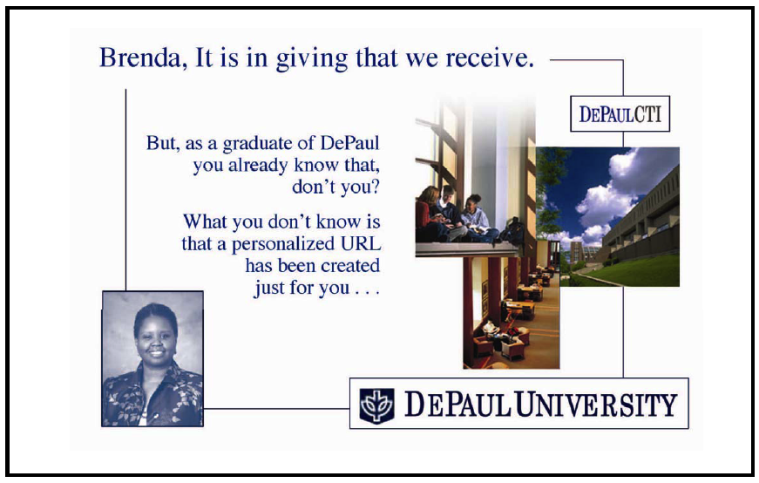
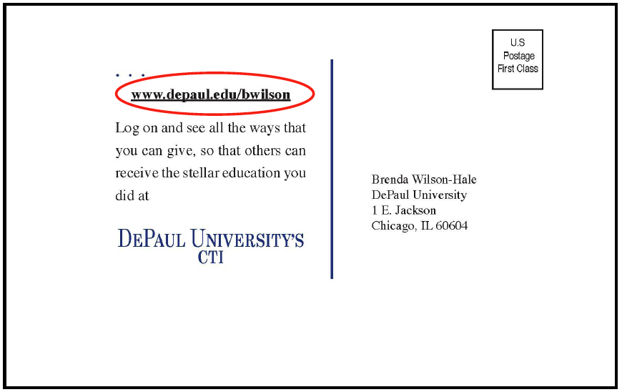
Sample: Alumni Fundraising

Slide 17
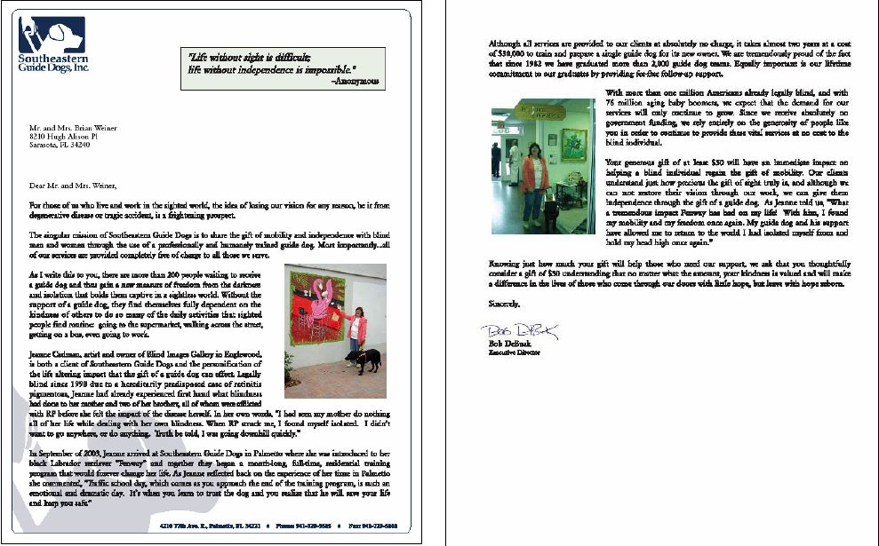
Sample: Fundraising

Slide 18
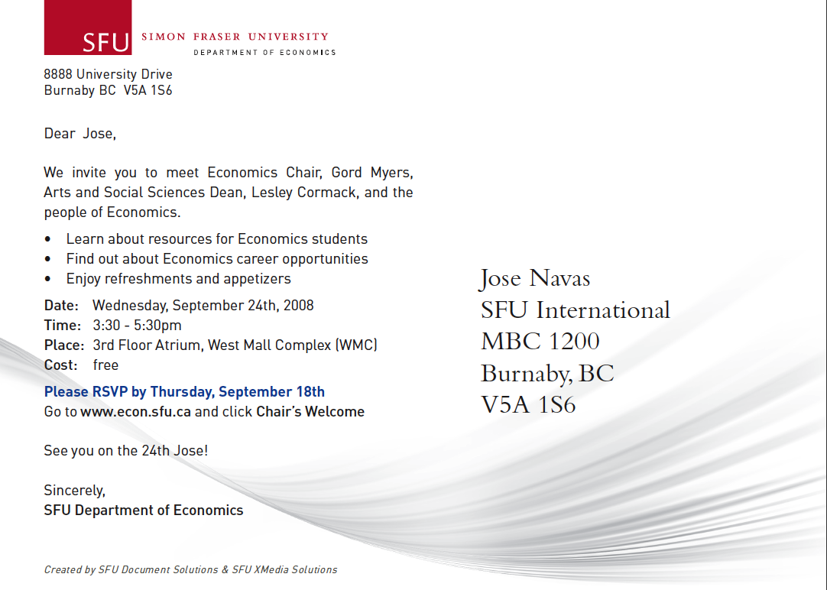
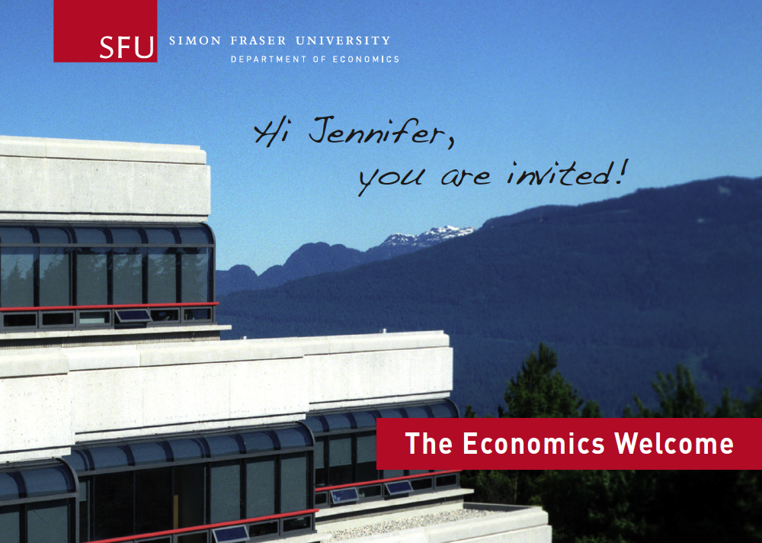
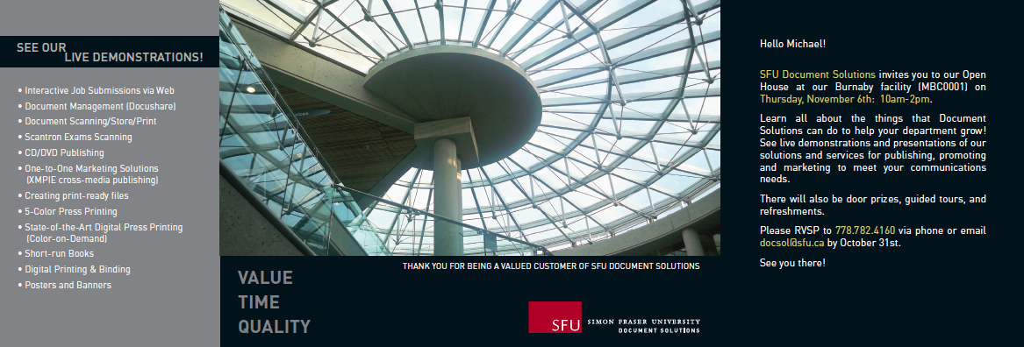
Sample: Event Awareness

Slide 19
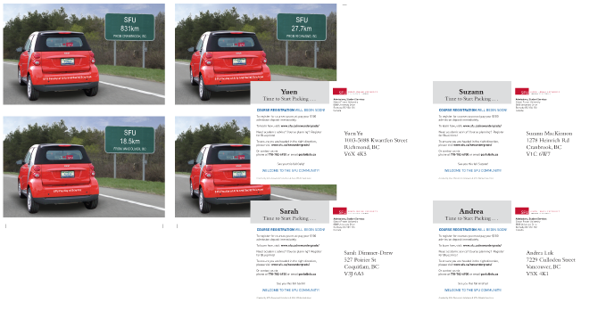
Sample: Recruiting
Printed materials were produced using an online application, followed by an email, and a personalized webpage.

Slide 20
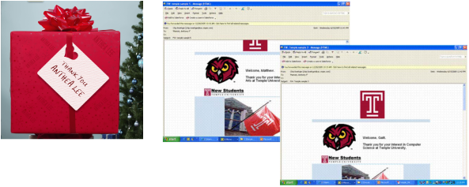
Sample: Personalized Email
This is a method of following up so as to reinforce the message that you have already conveyed using print and web medium
This is consistency and recall

Slide 21
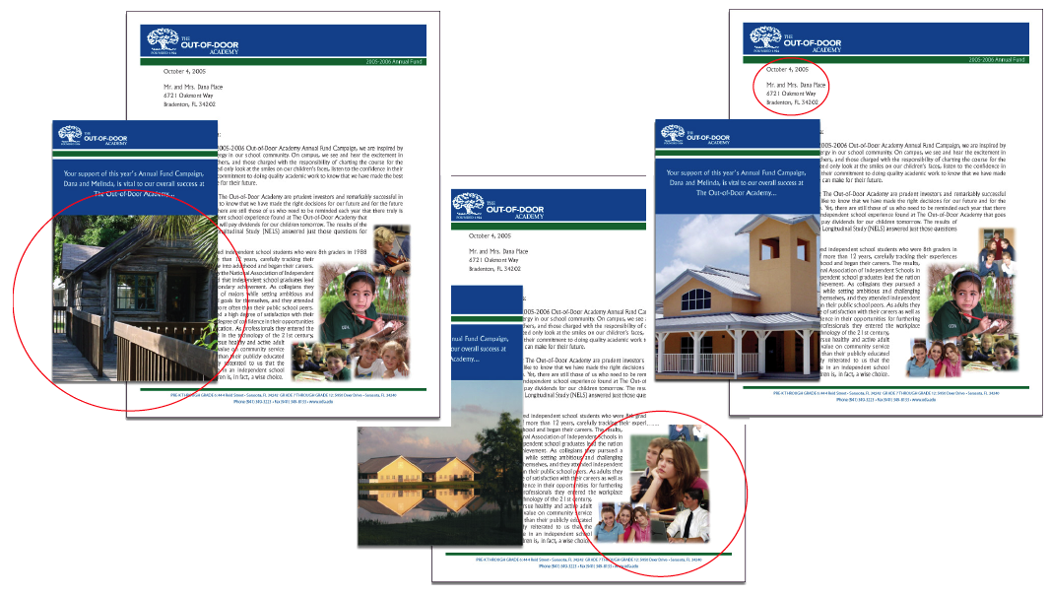
Sample: Campaign

Slide 22
Sample: Campaign (Specifics)
Annual Giving Campaign for Special School Operational Needs
Personalized pieces using
Unique and special faculty quotes driven into copy of each individual student/parent recipient
Previous giving history included
Name of caller
Coordinated Multi-touch Approach
General Awareness Letter
1st, 2nd, 3rd Appeal Letters
Phone-a-thon Postcard
Final Appeal

Slide 23

Case Study: Student Recruitment
Objective
Reverse the trend of declining enrollment in college
Increase enrollments
Respond in a timely manner to requests for information
Build a relationship with multiple hits
Target prospective students with a strong, empowering, and cohesive message
Solution
Developed new marketing theme “Yes You Can”
Web Site Information Request
5 Consecutive Mailings with information personalized to the students
Results
Enrollments increased 15%,

Slide 24
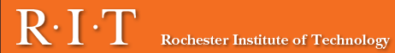
Case Study: Application Process
Objective
Make the application process more efficient and personal for new applicants
Increase the number of applicants
Increase application completion rate
Solution
Printed and mailed pre-populated applications to potential applicants with each student’s name, address, telephone, e-mail and name of high school already filled out.
Personalized RIT admissions Web site also made available to complete the pre-populated application online.
Reminded students about missing application information with an attention-grabbing postcard that highlighted the missing materials specific to the applicant.
Results
The programs contributed to a 16% increase in student applications.

Slide 25
Case Study: Student Orientation
Objective
Provide each student the information he or she needs to navigate the campus easily and attend the correct Orientation program without problems
Communicate students’ personal schedules, agendas, and activities so they will be better informed about the Orientation program
Direct students to the most convenient parking areas and provide dated guest parking permits
Solution
Postcard including student’s name, address, and date and time of orientation; the location and map (or maps); the parking permit for the correct lot; and the Orientation schedule and agenda.
Heavyweight paper made the piece easy to keep and carry for on-site reference.
Attached parking permit is perforated and die cut to fit around a rear-view mirror.
Results
Increased positive experience of first-time students reinforcing the belief that they have made the right choice in choosing to attend Boise State
Fewer lost, late, and unprepared Orientation attendees

Slide 26
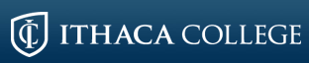
Case Study: Alumni Relations
Objective
Maintain relationship with alumni population
Solution
Postcards with personalized text and imagery to three demographic segments.
Personalized landing page with survey
Results
4,000 alumni visited personalized web page
1,700 completed surveys
Knowledge obtained from campaign used for planning future alumni communications

Slide 27
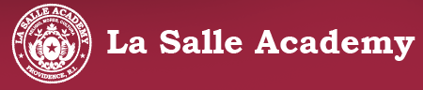
Case Study: Alumni Relations
Objective
Increase the donation amount received by active donors
Increase the number of donors by reaching out to alumni who are not active donors
Solution
11" x 17" self-mailer, personalized with the alumnus’ name, class year, and a representative photograph from the alumnus’ decade.
Classes were ranked from 1 to 10 within their respective decades based on the amount donated from each class to foster competition among the classes, and encourage participation
Results
The average gift amount rose from $150 per donor to $250 per donor, a 67% increase
The total number of donors increased

Slide 28
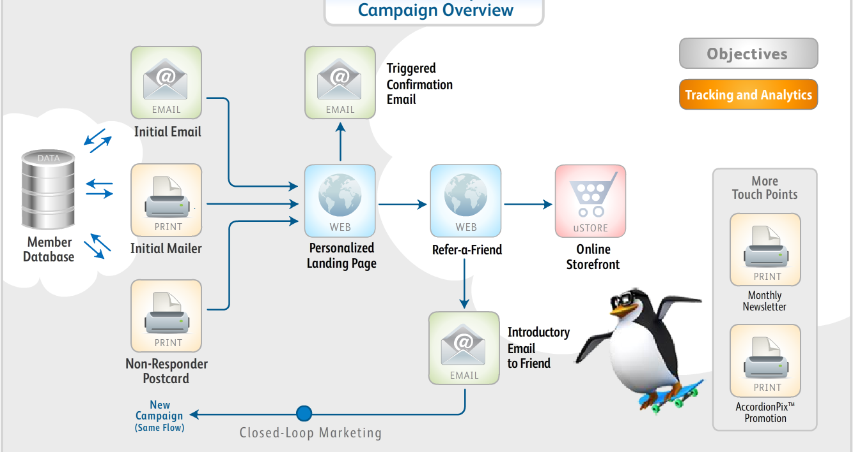
Are you ready to create your campaign?

Slide 29
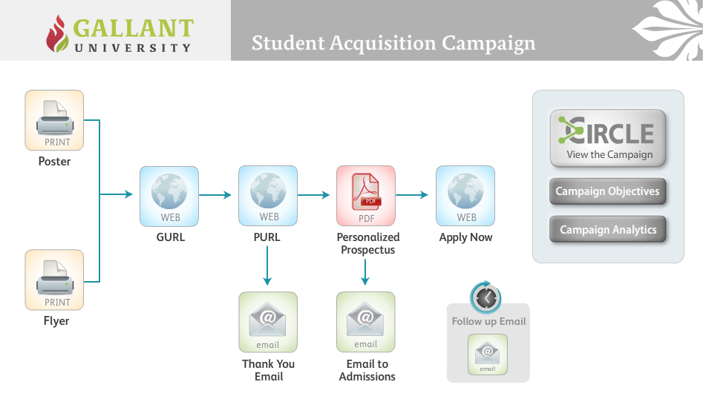
Are you ready to create your campaign?

Slide 30



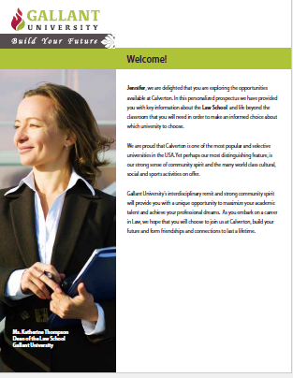

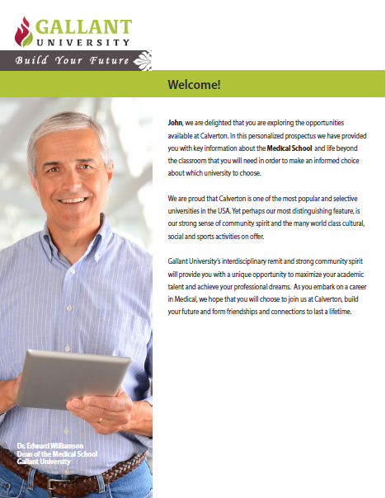
See the difference with your sample….

Slide 31
Next Steps
We believe that our personalized marketing approach would be beneficial to Webber International University
Metrovista would like to provide marketing knowledge and assist in executing your business goals at the university
Design
Campaigning
Marketing Materials
There is a mutual benefit for developing print and online marketing
Together we can create a program that will increase the prospective users interaction and engagement with the university.

Slide 32
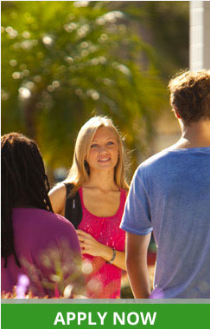
Questions?

